Slide 1
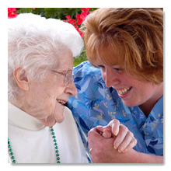
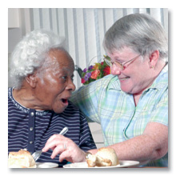
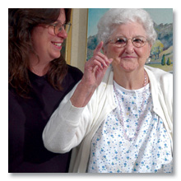
Advancing Excellence
in
America’s Nursing Homes
Beverley Laubert Becky Kurtz
Lori Smetanka Dawn Jacobs
Carol Scott
www.Nhqualitycampaign.org

Slide 2
Beverley L. Laubert
Ohio State Long-Term Care Ombudsman
Advancing Excellence Board of Directors, Chair
50 W. Broad Street, 9th Floor
Columbus, OH 43215-3363
614-644-7922 or 800-282-1206
Fax 614-644-5201
blaubert@age.ohio.gov
www.nhqualitycampaign.org

Slide 3
Campaign Overview
Largest national coalition (30 organizations) of nursing home stakeholders working together to help nursing homes improve care
Voluntary for nursing homes (61.3% or 9,599 NHs registered!)
Based on measurement of meaningful goals
www.nhqualitycampaign.org

Slide 4
How the Campaign Works
Board of
Directors
Statewide LANE
Recruits nursing homes
Nursing Home
Uses Campaign’s web-based resources for QAPI
Provides Support
Develops Resources
Sets Goals
Coordinates statewide activities
Provides support
Registers for AE
Selects 2 goals
Enters data on website
State initiatives

Slide 5
Becky A. Kurtz
Director, Office of LTC Ombudsman Programs Becky.Kurtz@acl.hhs.gov
Administration on Aging
Administration for Community Living
US Department of Health and Human Services

Slide 6
Why AoA/ACL engaged in AE
AE aligns with ACL’s goals:
ACL Strategic Goal 1: Advocacy
Objective: Engage federal policy makers and other partners to ensure existing policies and programs optimally reflect the interests of people with disabilities, older adults and their family members.
ACL Strategic Goal 4: Long-Term Services and Supports
Objective: Assist states to develop high quality, person-centered, and integrated systems that seamlessly address the health and long-term services and supports needs of people with disabilities and older adults.
http://www.acl.gov/About_ACL/StrategicPlan/docs/ACL_Strategic_Plan.pdf

Slide 7
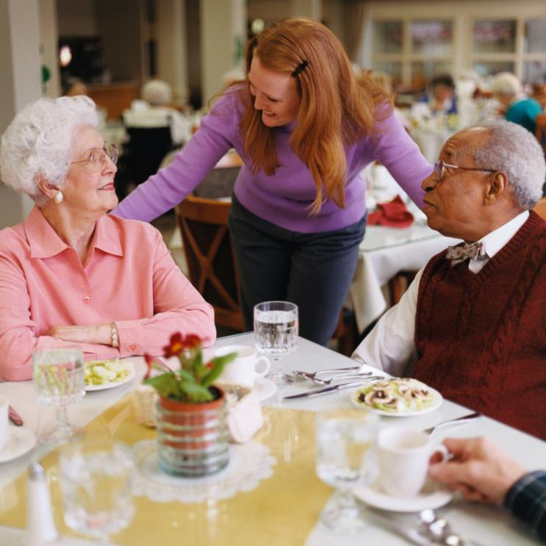
Why AoA/ACL engaged in AE
AE aligns with the duties of our Office:
Director of the Office of LTC Ombudsman Programs is to:
be “a visible and effective advocate on behalf of older individuals who reside in long-term care facilities . . . regarding all Federal policies affecting such individuals.” Older Americans Act Section 201(d)(3)(A)
“advocate, monitor, and coordinate Federal and State activities of Long-Term Care Ombudsmen” Older Americans Act Section 201(d)(3)(I)

Slide 8
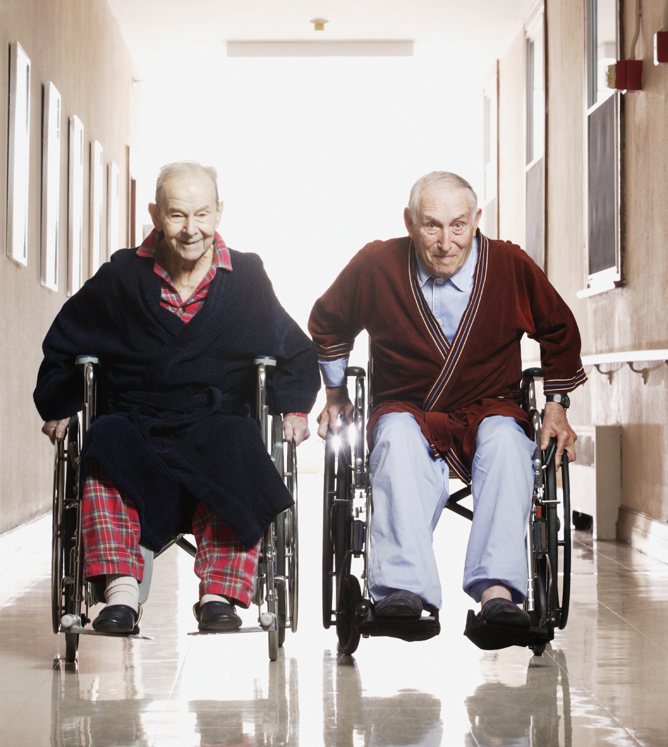
Encourage State and local engagement
AoA/ACL encourages States’ LTC Ombudsman Programs – at State and local/regional levels -- to be engaged in LANEs and other AE work to:
promote quality improvement and person-centered practices in nursing homes across the country;
develop strategic partnerships to support the interests of nursing home residents.

Slide 9
Lori Smetanka, JD
Interim Executive Director, The Consumer Voice
Director, National LTC Ombudsman Resource Center
1001 Connecticut Avenue, NW ,Suite 425
Washington, DC 20036
202-332-2275, ext. 206 lsmetanka@theconsumervoice.org
www.nhqualitycampaign.org

Slide 10
Dawn Jacobs
Michigan Assistant State Ombudsman
jacobsd3@michigan.gov
Role on the Michigan LANE
How the Ombudsman Program promotes AE
www.nhqualitycampaign.org

Slide 11
Local Area Networks for Excellence (LANEs)
53 LANEs
Over 250 organizations and individuals meet regularly throughout the year
Host over 100 trainings, webinars, learning sessions

Slide 12
To Do’s
“
Find out what your LANE is focusing on, and see how you might help
Check out the website and sign up as a consumer
See if the nursing homes in your area are registered for the Campaign
Offer to do a staff or resident/family council training on AE

Slide 13
Importance of Consumer Involvement
Excellent care is possible when we know residents’ ideas about their care and how it can be improved. Residents provide us with direction. When residents cannot communicate for themselves due to dementia or other conditions, their families or friends provide us with that guidance.

Slide 14
Involving consumers reminds us that the Campaign is about helping real people, and not just goals and data. This increases the motivation to succeed.
Resident participation in choosing the goals the nursing home addresses ensures that the nursing home is working on issues that are important to those who live in the home.

Slide 15
Goals are best achieved by including residents and families/friends as partners. In any organization, people who are affected by a proposed change want to understand what’s being changed and why. Giving consumers the opportunity to ask questions and shape the change can help make the change more successful and lasting.

Slide 16
Expectations of nursing homes are raised when consumers participate. Higher expectations create stronger incentives for nursing homes to achieve their goals.
Residents and their families and friends can provide ongoing encouragement and support to nursing homes. Their involvement creates a sense of team and everyone “pulling together,” making it more likely that a nursing home will achieve the goals they set.

Slide 17
Involving consumers raises public awareness and increases the visibility of both the Campaign and its message. This brings more national attention to the issue of nursing home quality and increases public demand for good care. Greater visibility also makes Advancing Excellence accountable to consumers, and the Campaign more likely to deliver the excellence it promises.
Finally, consumer involvement helps build the momentum that is necessary for success.

Slide 18
AE tools can help NHs meet the new QAPI
New CMS Quality Assurance/ Performance Improvement emphasize
problem identification,
data collection,
root-cause analysis,
performance measurement and tracking
With the shift to MDS 3.0 and the change in quality measures, NHs are more accountable than ever for quality.
www.nhqualitycampaign.org
Notes:
All the things that QAPI will be emphasizing are built into AE’s free resources for NHs
Performance improvement: it’s the right thing to do

Slide 19
What the workgroup developed or identified
Advancing Excellence & QAPI
Use one of AE’s Goal “packages” of resources to improve care and become QAPI compliant
AE’s Circle of Success – PDSA change framework for systematic performance analysis leading to systemic action (QAPI Element 5)
Data measurement & tracking tools (QAPI Elements 3, 4 and 5)
Root cause analysis tools – called “Probing Questions” (QAPI Element 5)
Consumer, staff, and leadership fact sheets (QAPI Element 2)

Slide 20
Quality Assurance | Performance Improvement
Reactive | Proactive
Episode or event-based | Aggregate data and patterns
Prevent recurrence | Optimize process
Sometime anecdotal | Always measurable
Retrospective | Concurrent
Audit-based monitoring | Continuous monitoring
Sometimes punitive | Positive change

Slide 21
AE’s Working Hypothesis:
If you have good organizational workplace practices and good care planning practices, the good clinical outcomes will follow and the staff/residents/families will be happy.
www.nhqualitycampaign.org
Notes:
*

Slide 22
A Model for Change
Outcomes
Organizational Workplace Practices
Person-centered Care

Slide 23
2013 AE Goals
Hospitalizations
Staff Stability
Pressure Ulcers
Medications
(Antipsychotic use)
Consistent
Assignment
Infections
Mobility
Person-Centered
Care and
Decision-Making
Pain Management
Notes:
There are the areas consumers and the public care about most.
Malcolm Sparrow

Slide 24
A package of tools for each goal
Each goal has:
Data gathering or tracking tool
A series of fact sheets to inform:
Consumers
Staff
Leadership
“Probing questions” – examples of the types of questions NHs might ask as they do their root-cause analysis
Links to useful resources
www.nhqualitycampaign.org
Notes:
Note: The tracking tool is for “internal” use only because it contains resident specific data. It should not be shared outside the home unless information is “de-identified”. Only aggregate data is uploaded from this tool to the AE website. The advantage to NHs of doing this is they can then compare their performance to other NHs and show results.

Slide 25
Other improvements
Addition of “process” measures built into the tracking tools to help with root-cause analysis.
Website entry for each goal and integration with nursing home–wide QAPI
Increased feedback from the website for use by Performance Improvement Committees.
www.nhqualitycampaign.org

Slide 26
Re-defining “participation”
New definitions:
Registrants: NHs which sign up but don’t consistently enter data
Participants: NHs which demonstrate commitment to principles of performance improvement by entering data
To sign up for the campaign NHs must chose at least 2 goals – One process goal (consistent assignments, staff stability, reducing hospitalizations or person-centered care) and one clinical goal (mobility, infections, pressure ulcers, pain and medications).
To be considered a participant:
Data should be uploaded onto the website monthly for at least 1 of the 2 selected goals for 6 consecutive months.
For the 2nd selected goal monthly data entry is optional in the first year but must be entered by the second year.
www.nhqualitycampaign.org

Slide 27
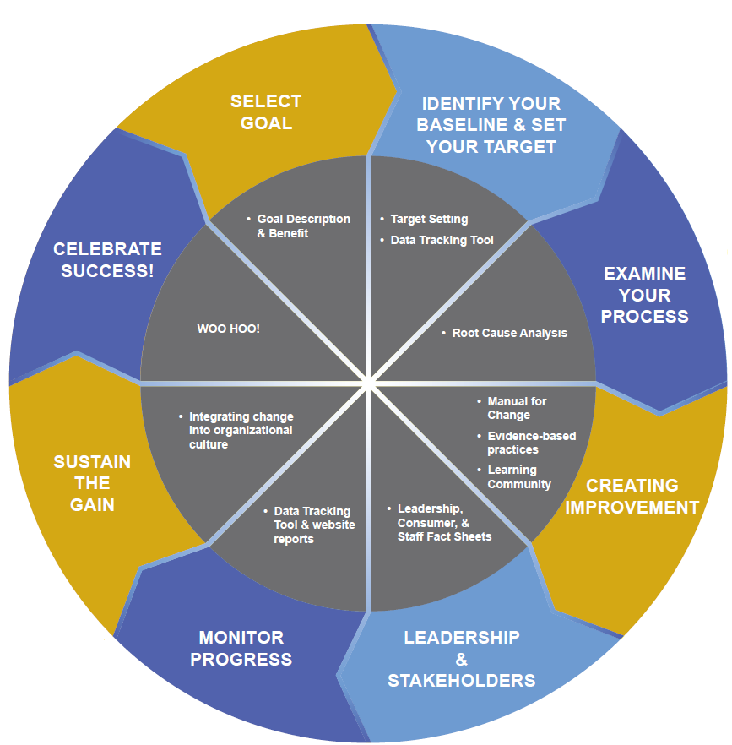
Data and the Quality Improvement Process
How do I know where I am?
Where do I want to be?
What processes are associated with my outcome?
When I change a process, how do I know it had the effect I wanted?
How am I doing compared to other nursing homes working on this goal?

Slide 28
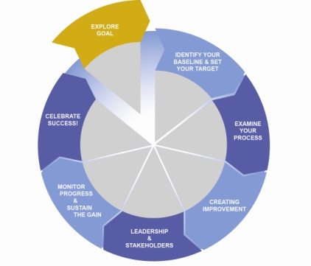
PlanDoStudyAct

Slide 29
Explore the Goal

Slide 30
www.nhqualitycampaign.org

Slide 31
Engage

Slide 32
Advancing Excellence:
Because performance improvement is the right thing to do!

Slide 33
Questions?

Slide 34
for making our nursing homes better places to live, work, and visit!

